Slide 1





UI Redesign
Enhancing User Experience
Group Project 1 – TEAM 2
Nagamedha Sakhamuri
Mohammed Sami Ahmed
Nookaraju Guttula
Notes:
"Good Evening everyone. We are a team of 3, Myself Medha, this is Sami and he is Raju. Our team started this project by aiming to redesign an app with a large user base to ensure strong needfinding opportunities. We searched for most widely used shopping app globally and Amazon is first so We finalized Amazon mobile application.
Despite its popularity, we asked ourselves — would there even be any real usability issues?
Through detailed research — analyzing app reviews, Reddit discussions, and user complaints — we uncovered several recurring pain points users faced every day. we are excited to present our project on enhancing the Amazon Shopping mobile app experience through a focused UI redesign."

Slide 2
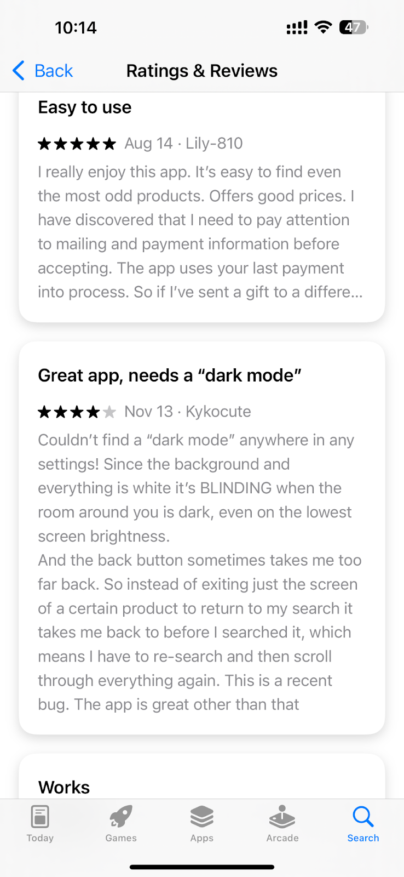
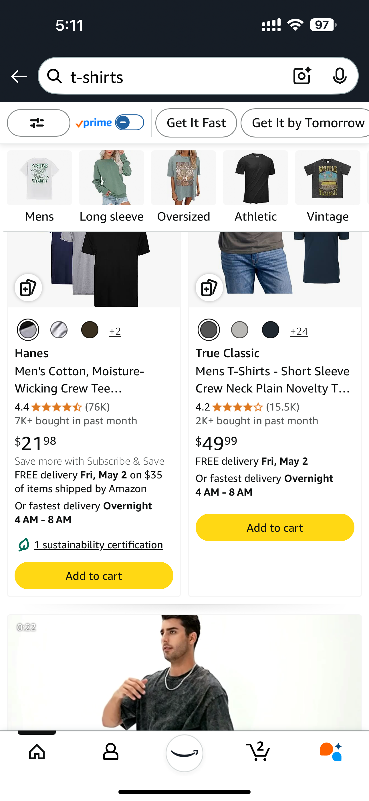
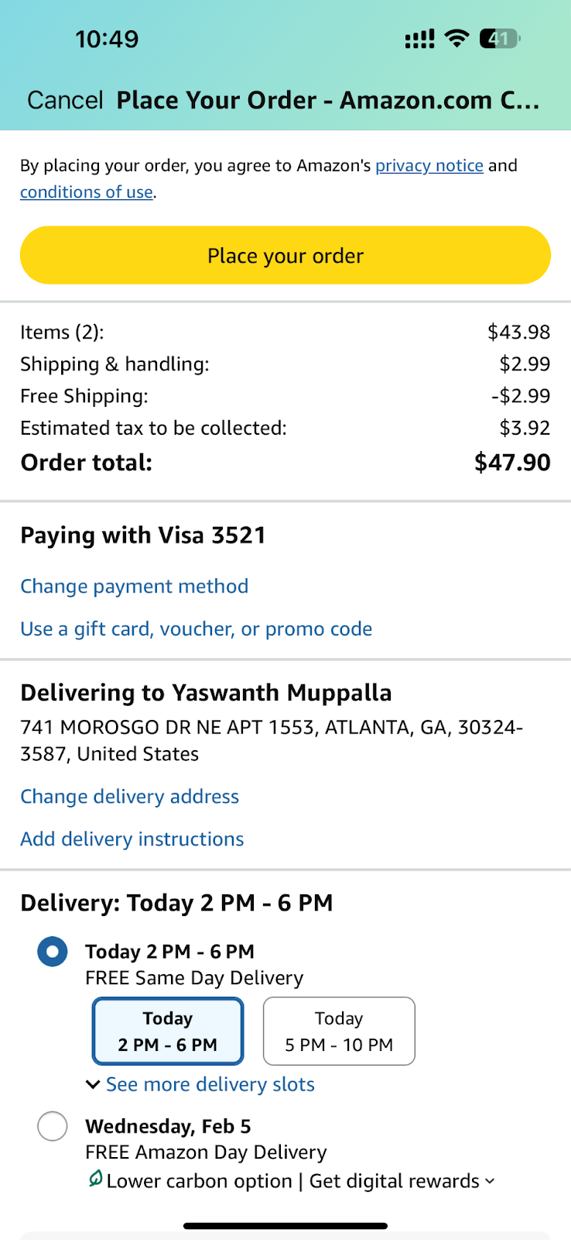
PASSIVE NEEDFINDING
WHY REDESIGN?
Notes:
"Initially, we analyzed passive data — app reviews on app store, play store, and Reddit and quora discussions and interviewing amazon users.
> Here you can see a user review on App store where he mentioned Dar mode is needed, so it doesn't strain his eyes because of that brightness or whatever the dark mode is designed for.
>Then some users mentioned like they end up scrolling as there is no pagination or total no.of search resuts. No proper filter and sort option also they mentioned.
>Some causal interactions with amazon users , they mentioned, they ended up delivering their order to wrong location because its too invisible and doesnt highlight that part where the change delivery address is and you just keep whatever is there and later you realize its wrong address and its a hassle to cancel and order again to right location.
Even though Amazon is popular, we found recurring user complaints that showed clear usability issues, especially on the mobile app."

Slide 3
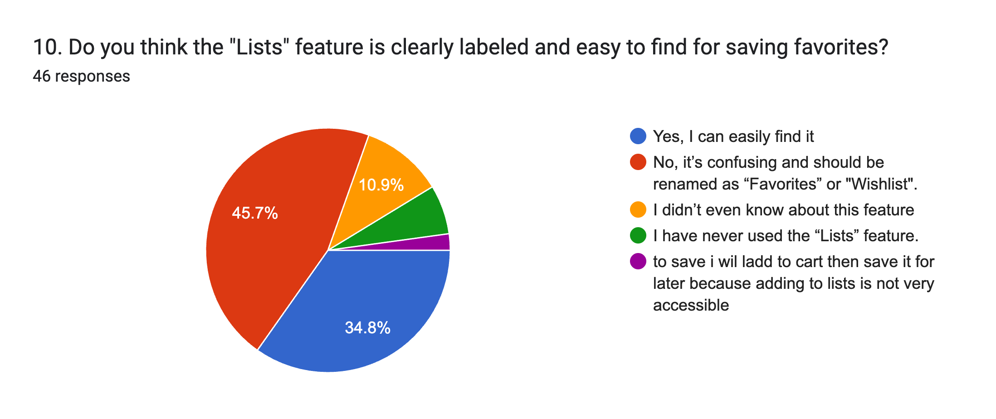
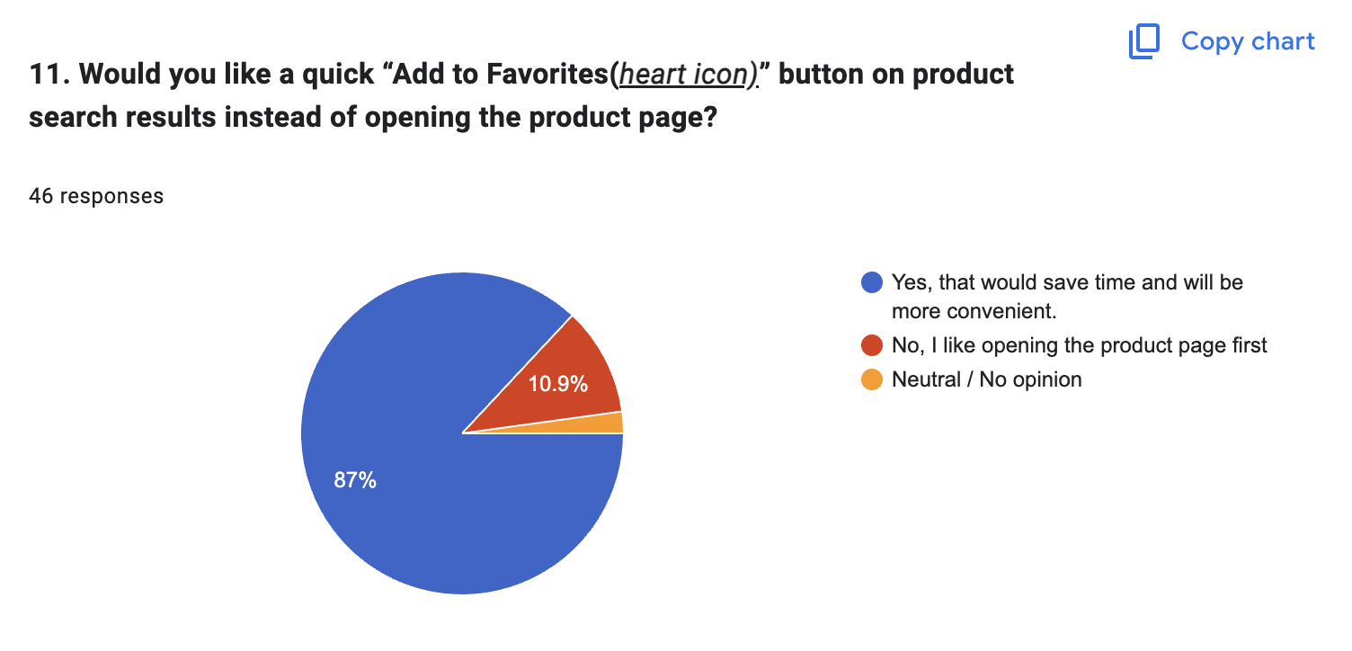
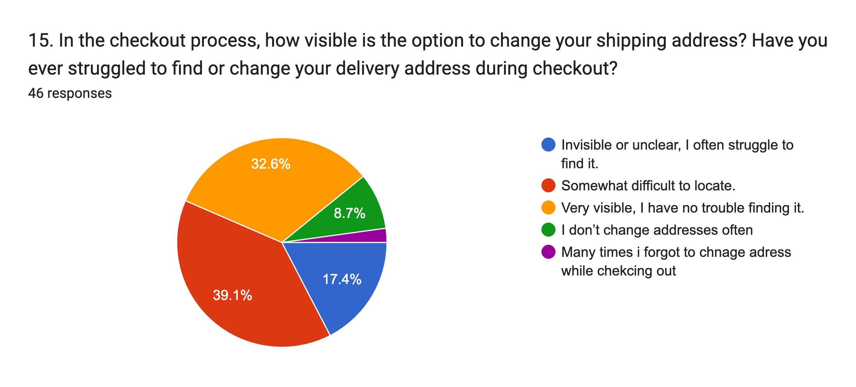
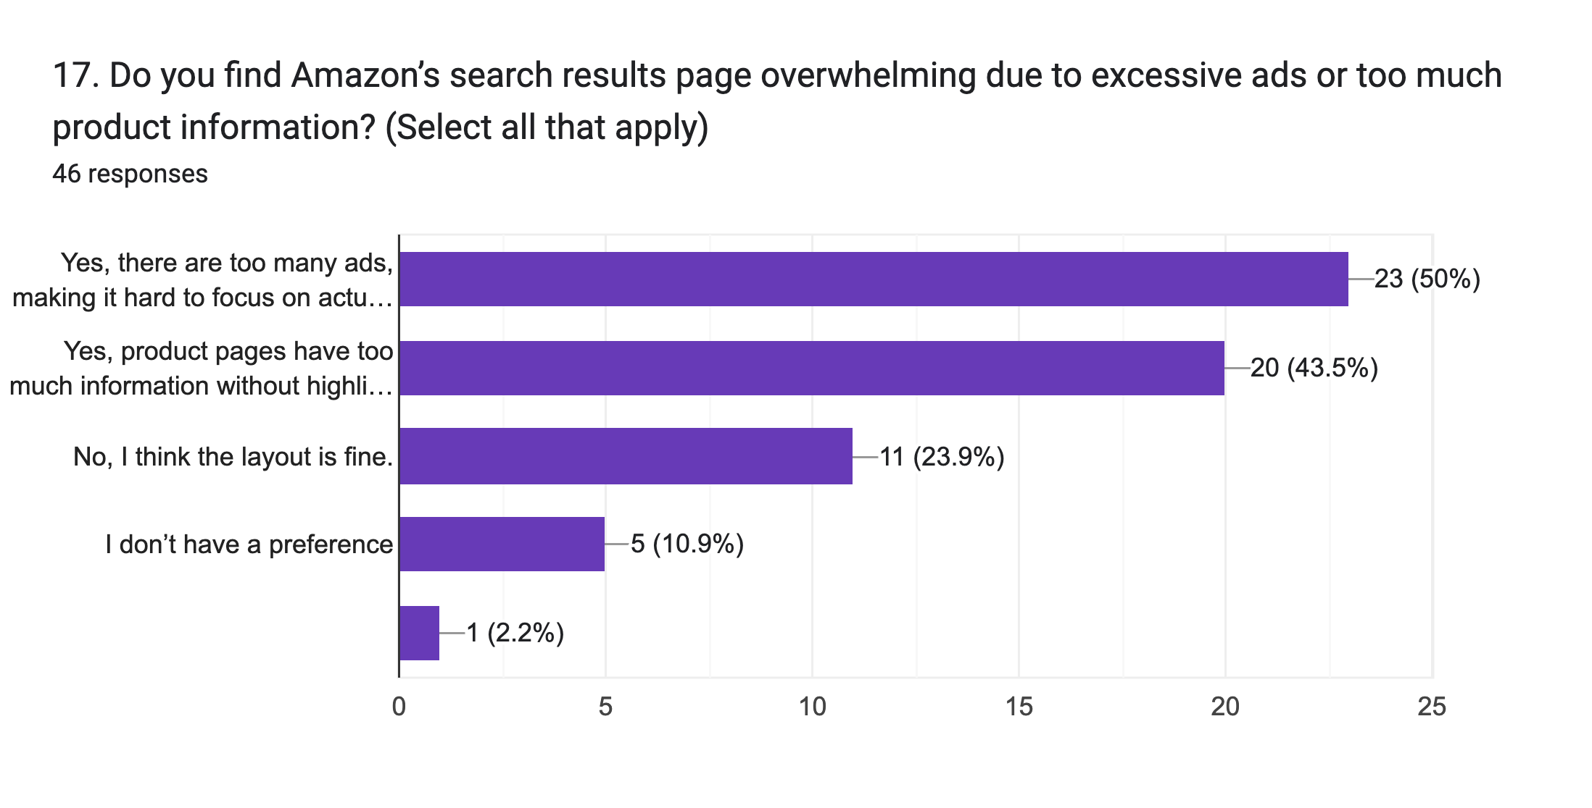
INTERACTIVE NEEDFINDING
WHY REDESIGN?
Notes:
"To validate what we found passively, we launched an interactive user survey. We surveyed over 46 participants and gathered deeper insights into user frustrations, confirming the gaps that needed redesign."
See how many want a favuorites icon on the results grid when you search for something and its hard to find it as it says lists and not wishlist or favuorites
some says home page needs to be decluttered with relevant information.

Slide 4

Heuristic Evaluation
WHY REDESIGN?
Surveyed 46 users and analyzed app reviews
User Pain Points:
1. Dark Mode missing
2. Endless Scrolling, no pagination
3. Favorites/Wishlist hard to find
4. No Quick Favorite button
5. Address Change hard during checkout
6. Homepage navigation issues
7. Ad clutter and overwhelming info
https://docs.google.com/forms/d/1dcKizipVGLkKJZmTtJpI4Swk3QCpolBsLH0tO8Pr1Bs/edit#responses
Notes:
"We started with passive needfinding, then validated our findings with a survey gathering 46+ real users’ responses. Then we analysed both our needfindings and Here are the 7 key issues we identified and decided to redesign.
Dark Mode missing: 51% users requested it for eye comfort.
Endless Scrolling: 47% frustrated by not seeing product count or pages.
Favorites/Wishlist Access Issues: 45% couldn't easily find saved items.
No Quick Favorite Button: 87% wanted a heart button in search results.
Changing Address during Checkout is hard: 56% missed it.
Homepage Navigation: 50% wanted easier shortcuts to Favorites/Wishlist.
Ad Clutter and Overwhelming Product Info: made browsing frustrating.
"These insights highlighted important opportunities to enhance the Amazon app's user experience."
here is the link to our survey responses we have taken.

Slide 5
DESIGN APPROACH
HCD + HCI Principles
Human-Centered Design Process:
Needfinding → Heuristic Evaluation → Prototyping → Evaluation
HCI Principles:
Affordances (Favorites Button)
Perceptibility (Clear counts)
Mapping (Consistent Layout)
Flexibility (Dark Mode)
Feedback (Confirmation Messages)
Notes:
"We followed a structured Human-Centered Design Process:"
Needfinding: Identified real user frustrations.
Heuristic Evaluation: Mapped issues against 15 HCI Principles like Affordances, Perceptibility, Mapping, Flexibility, and Feedback.
Prototyping: Designed a high-fidelity Figma prototype, completely custom-built.
Evaluation: Gathered new feedback after prototype deployment.
"Applying key HCI principles:"
Affordances: Added a visible Heart button for saving Favorites easily.
Perceptibility: Made product counts and Change Address options highly visible.
Mapping: Ensured consistent layouts across all pages.
Flexibility: Enabled a Dark Mode toggle for user preference.
Feedback: Provided immediate visual confirmation for user actions.
"These principles helped ensure every redesign decision was purposeful and user-centered.” or "We followed a complete Human-Centered Design Process — starting with Needfinding, followed by Heuristic Evaluation, Prototyping, and User Evaluation. We mapped everything to HCI Principles like Affordances, Perceptibility, Mapping, Flexibility, and Feedback to ensure a user-centered redesign."

Slide 6
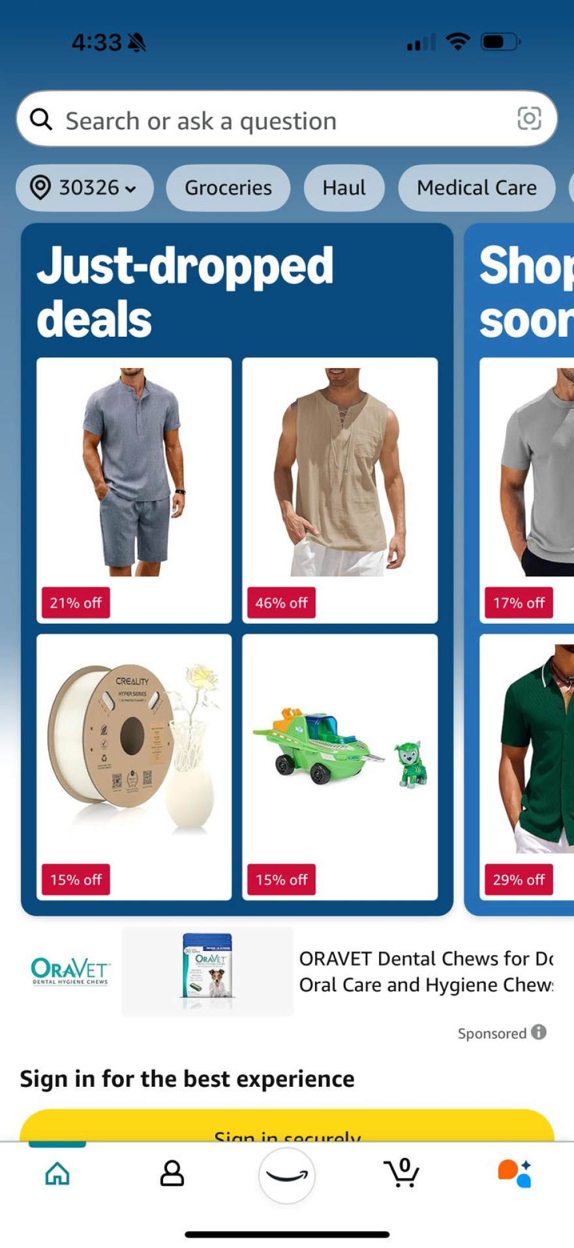
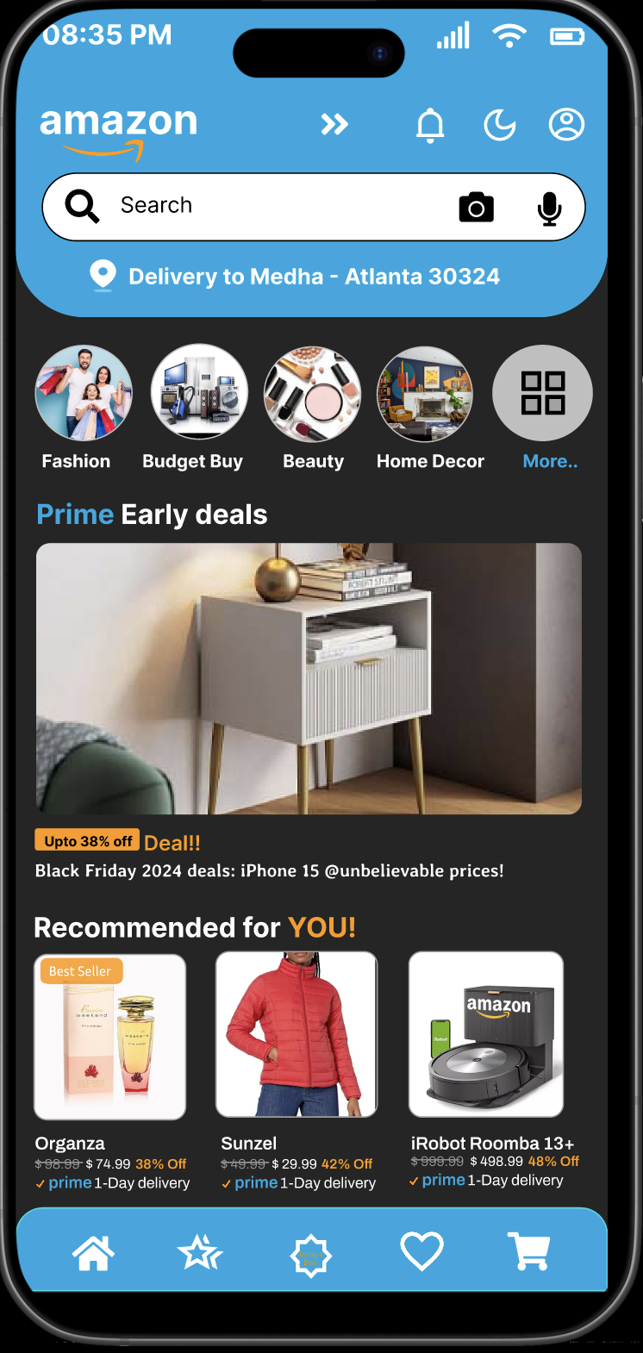
PROTOTYPE WALKTHROUGH
https://www.figma.com/design/v47gqSJYUtMqwLDkOnQO8U/AHCI?node-id=129-2&m=dev&t=w8U4qzeDBYkDgSQZ-1
Notes:
Here is a walkthrough of our redesign we did.
On the left is how the homepage looked previosuly.
.On right you can see the new redesigned Homepage: Dark Mode toggle + Wishlist icon and decluttered with no ads and irrelevant information.

Slide 7
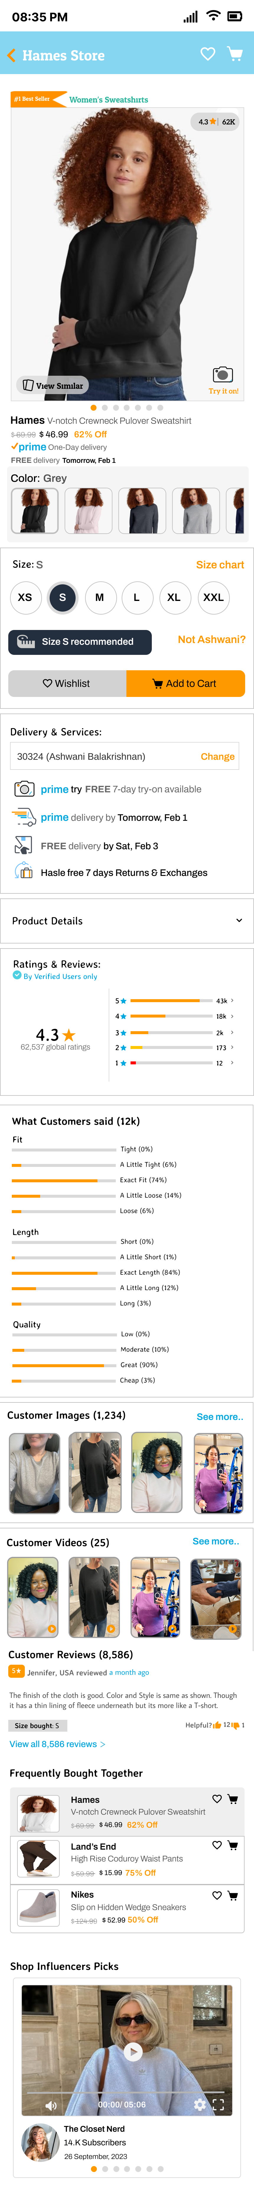
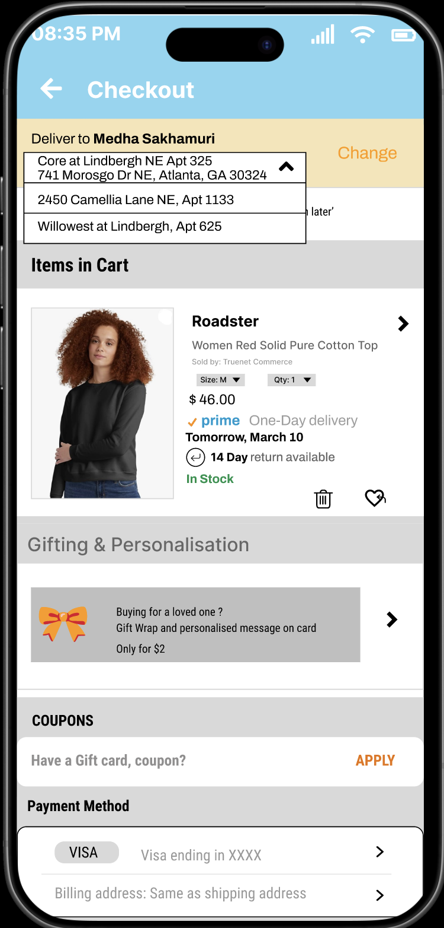
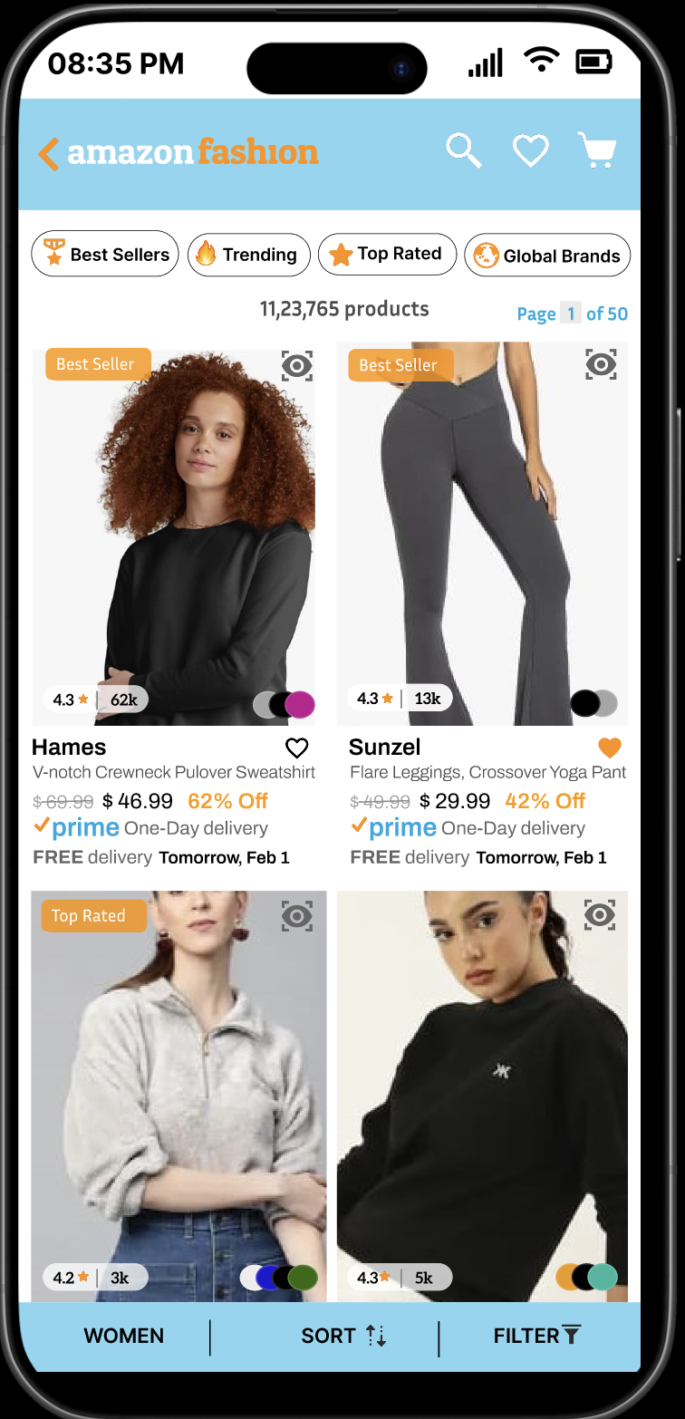
PROTOTYPE WALKTHROUGH
https://www.figma.com/design/v47gqSJYUtMqwLDkOnQO8U/AHCI?node-id=1-2&t=nL9Pq2rdaCYzAQKz-0
Notes:
Search Results: Pagination added + Quick Favorite button
Checkout Page: Change Address made prominent
Product Pages: Cleaner layout, fewer ads, more focus on product info
On the left you can see how change address previously is and in our redesign we moved it to the top making it viible and with a different color on the top which gets user attention and they can pick the adress from drop down. > then this is one more fix we did, like on the list of items you hav save to wishlist option directly, you can add items to favuorite and then review them again and order the final one form your wishlist.. Also if you see they are clear sort, filter options. and you can also go to cart and your lists page directly from any page, making the navigation easy for the user. Also there is pagination and no.of search results to prevent endless scrolling
>Then this is the product page, with only relevnt information and no ads over here also just the needed information we kept.
so these are the major highlights of our redesign, where we adressed the 7 shortlisted issues form our needfinding. And here is the link to entire figma design

Slide 8
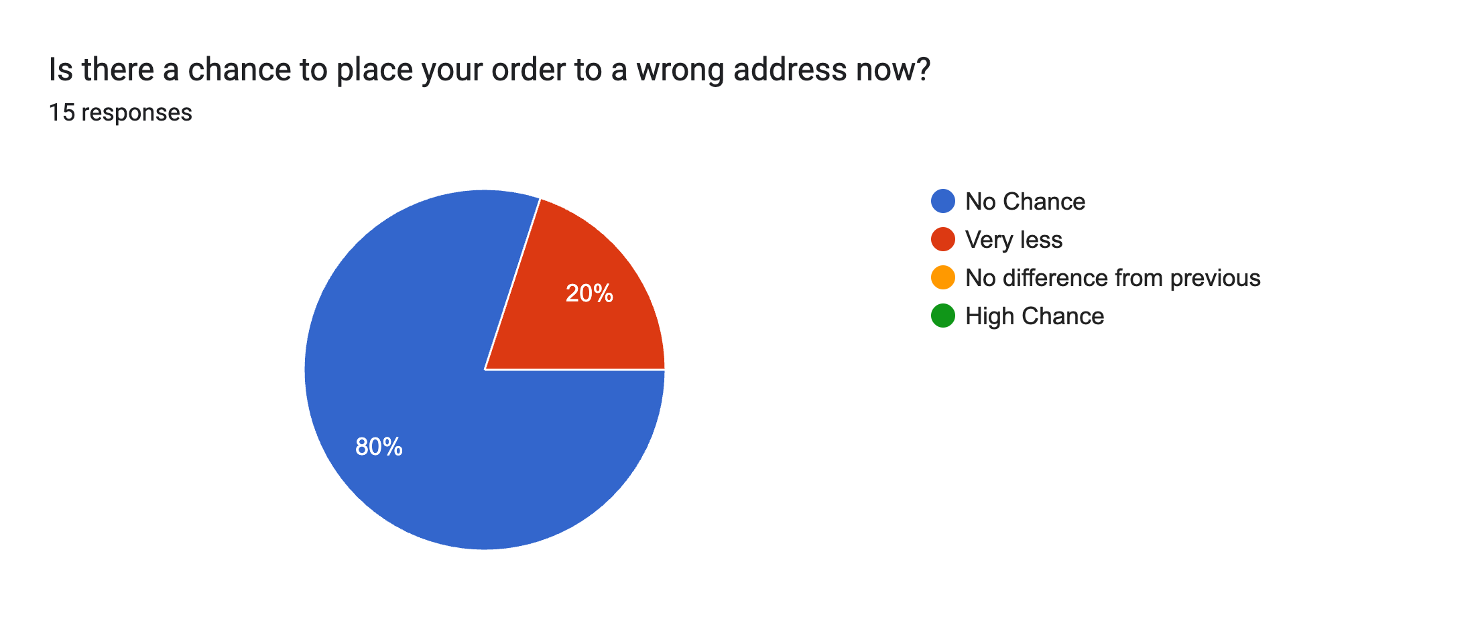
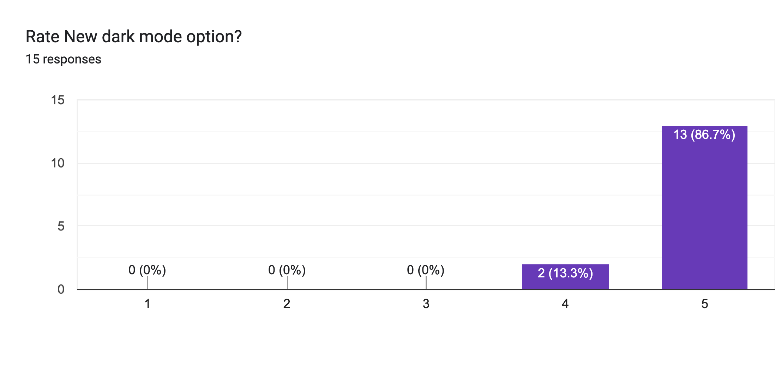
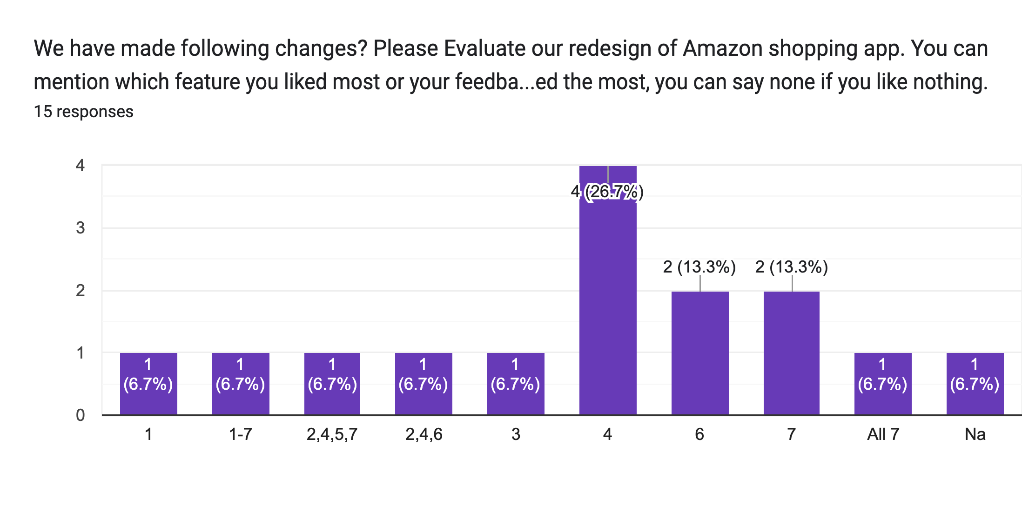
EVALUATION RESULTS
https://docs.google.com/forms/d/1_J6OQNWtOzVblorhWqn1hNynU9gaBlUif37xAQ6Fa3M/edit#responses
Notes:
After redesigning the Amazon app prototype, we conducted an empirical evaluation using user surveys to validate our improvements."
"Here are the key results:"
First Chart (Pie Chart - Address Change Chance):
"When asked whether users still felt there was a chance of ordering to the wrong address, 80% of participants said there is now no chance, showing that making the 'Change Address' option more visible was highly effective."
Second Chart (Bar Graph - Dark Mode Rating):
"For the Dark Mode addition, 86.7% of users gave it the highest rating of 5 out of 5, indicating strong approval of the new accessibility feature."
Third Chart (Bar Graph - Overall Redesign Feedback):
"When asked to evaluate the different changes we implemented, most users chose Option 4 — praising the favorites button addition and simplified navigation experience. 21.3% of users also highly appreciated multiple changes together."
For all 7 identified pain points, the evluation results were positive.
"Through our redesign, we directly addressed real user pain points, improving key areas like dark mode, navigation, favorites access, and checkout clarity. Our prototype is built with high fidelity, focusing on real user feedback, strong HCI principles, and usability improvements — demonstrating clear quality, clarity, and user impact."

Slide 9
ACHIEVEMENTS
Why Our Redesign Matters?
Positive user feedback and satisfaction
Solves real user frustrations and improves user satisfaction.
Grounded in usability and HCI principles
Makes shopping smarter, faster, and more accessible
Future Scope: To further refine user experience
Adjustable Grid Size
Advanced Filters in Saved for Later
https://www.figma.com/proto/v47gqSJYUtMqwLDkOnQO8U/AHCI?page-id=0%3A1&node-id=129-1006&viewport=-7806%2C-1988%2C1.09&t=3X9ImkWtu9Dz6tYp-1&scaling=scale-down&content-scaling=fixed&starting-point-node-id=1%3A2
Notes:
"Despite pivoting late from our original Pet app idea, we successfully solved 7 out of 9 key pain points. Our redesign improved real user frustrations, and user feedback was highly positive. "Our redesign is grounded in real user data and HCI principles. It makes shopping smarter, faster, and more accessible — proving that even the best apps have room for improvement when you truly listen to users."
For the future, we plan enhancements like Adjustable Grid Sizes in search and Advanced Filters for Saved for Later."

Slide 10

THANK YOU!
For you for paying attention
Open to any Questions/Feedback you may have!
Notes:
"Thank you all for your time and attention. We are open to any questions or feedback you may have!"

